Slide 1




#msdevtour

Slide 2

Облако Azure
Алексей Боков
Евангелист Microsoft Azure

Slide 3


@abokov
Эта презентация уже выложена здесь:
twitter.com/abokov

Slide 4
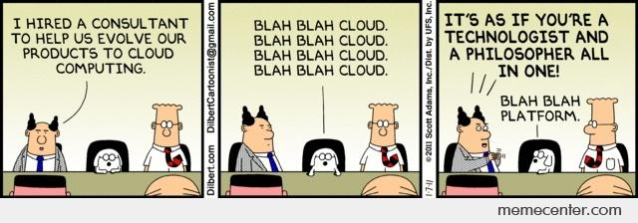
Зачем нам облачные технологии?

Slide 5
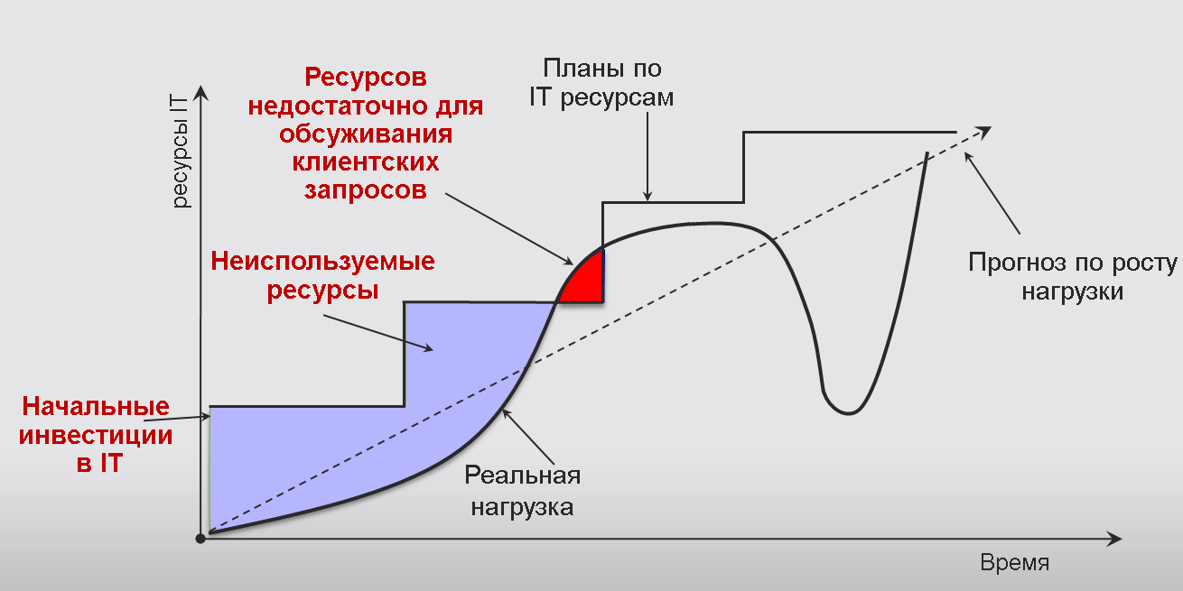
Традиционная IT инфраструктура

Slide 6
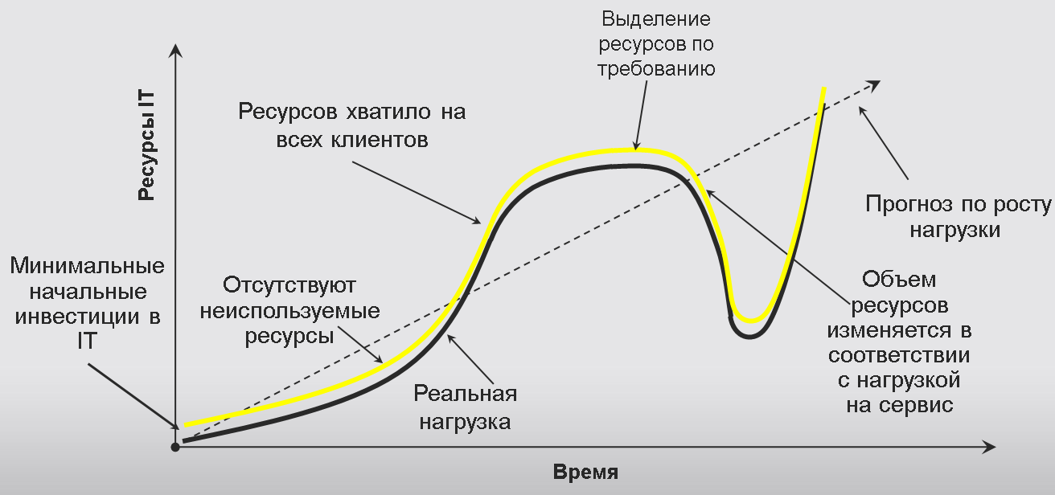
IT инфраструктура в обалке

Slide 7
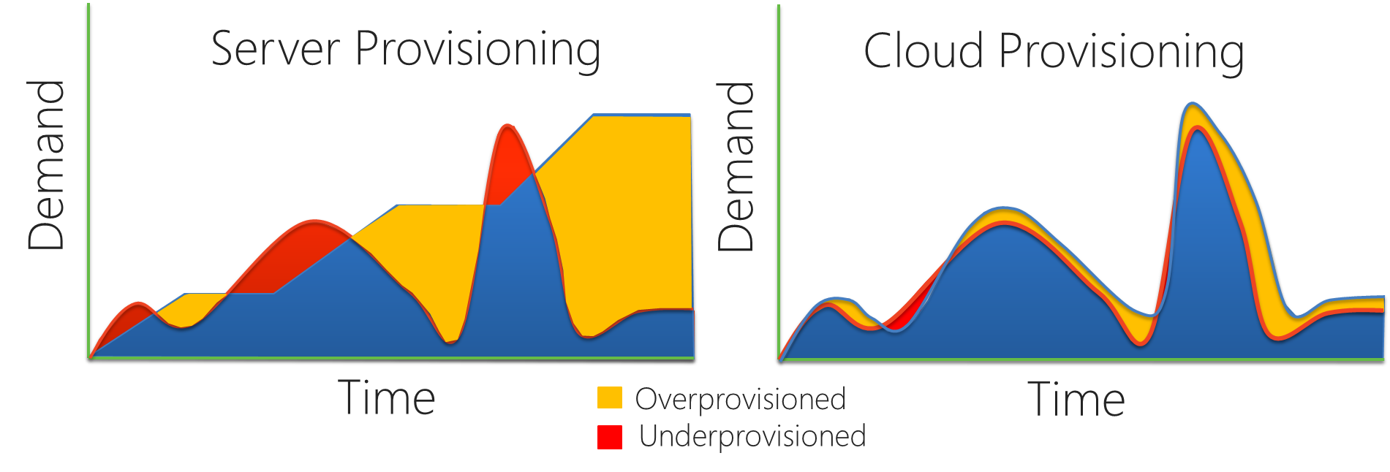
На самом деле вот :

Slide 8
Тенденции разработки приложений

Slide 9
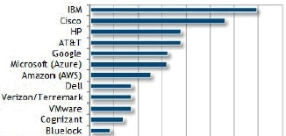

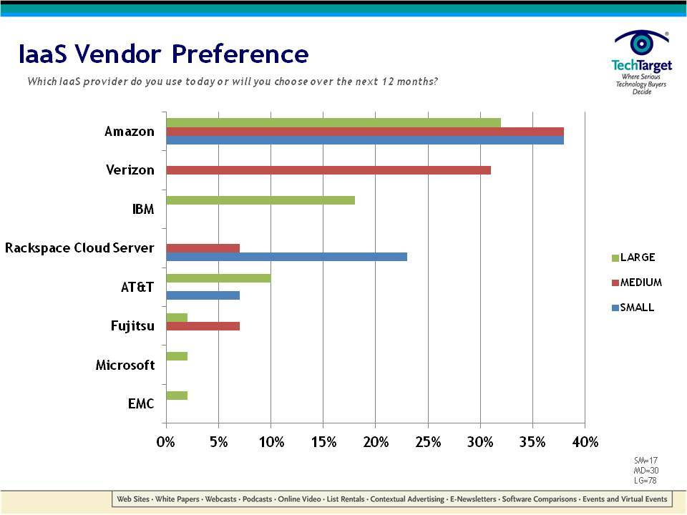
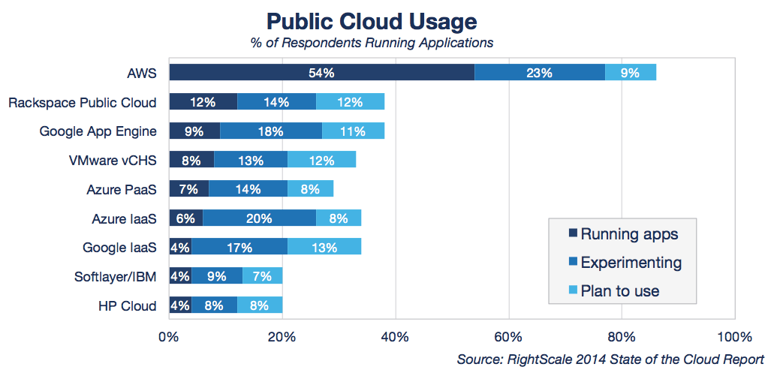
Глобальные облака – кто где
Notes:
1,000 new customers per day
1,000,000 cores milestone achieved September last year
1.6 Hexabyte milestones achieved at the end of last year

Slide 10
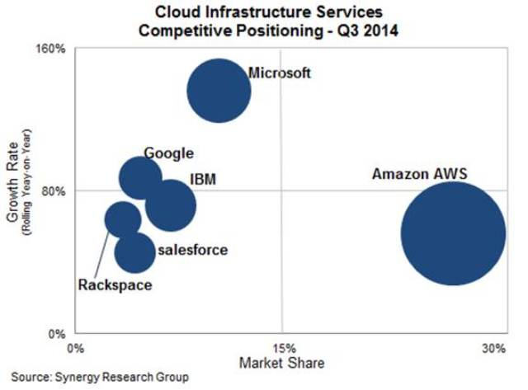

На самом деле все как то вот так
Notes:
1,000 new customers per day
1,000,000 cores milestone achieved September last year
1.6 Hexabyte milestones achieved at the end of last year

Slide 11
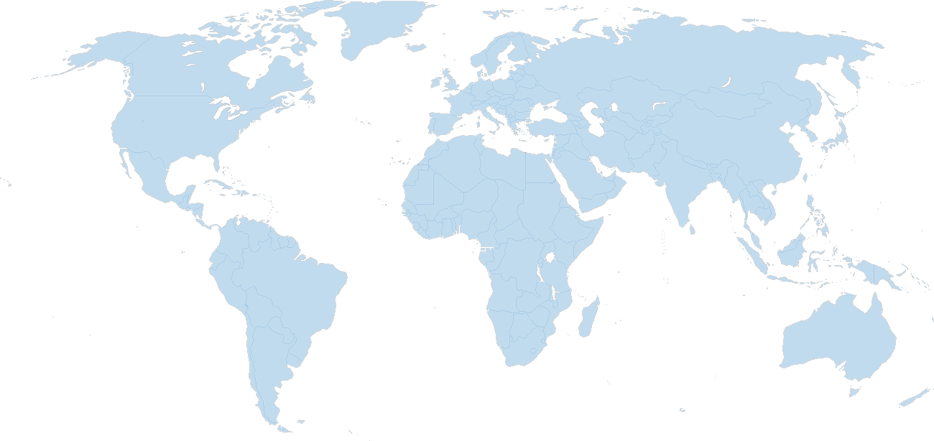


Microsoft Azure : 13 datacenter locations
East US
North Europe/ Dublin
Japan East/ Saitama
West US
China South+North/
Vianet21
West Europe/ Amsterdam
North Central US
South Central US
Japan West / Osaka
East Asia /Hong Kong
South East Asia/ Singapore
13 datacenters
- 4th generation ITPAC
- size ~ 28 100 sq.meter
- power ~ 16 MWt
- PUE ~ 1.05-1.22
- cost ~ 500М $
Brazil South / San Paulo (preview)

Slide 12
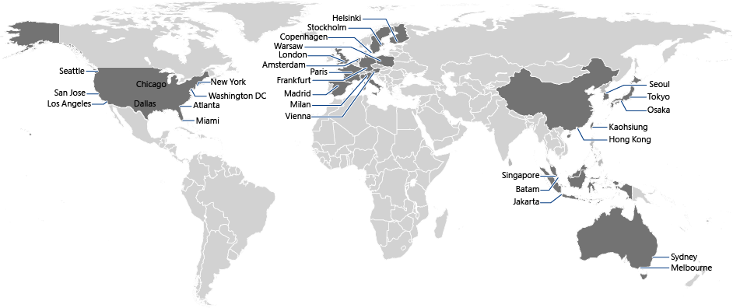
Global Azure Content Delivery Network
Node locations list on world map aka.ms/cdn-map
29 CDN nodes: Atlanta, Miami, NY, Washington DC, Chicago, Dallas, Los Angeles, San Jose, Seattle, Copenhagen, Helsinki, Stockholm, Vienna, Warsaw, Amsterdam, Frankfurt, Milan, London, Madrid, Paris, Batam, Hong Kong, Jakarta, Kaohsiung, Singapore, Melbourne, Sydney, Tokyo, Osaka

Slide 13
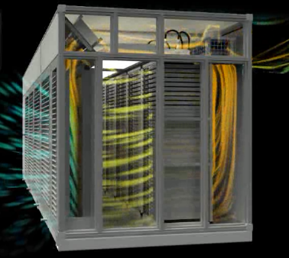
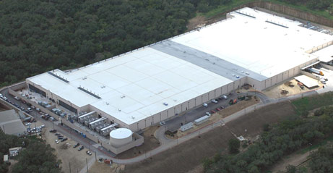
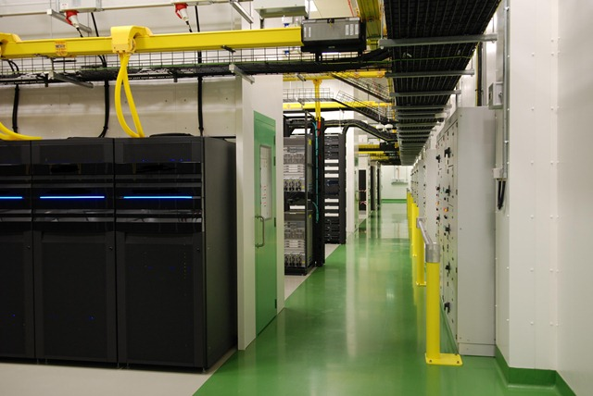
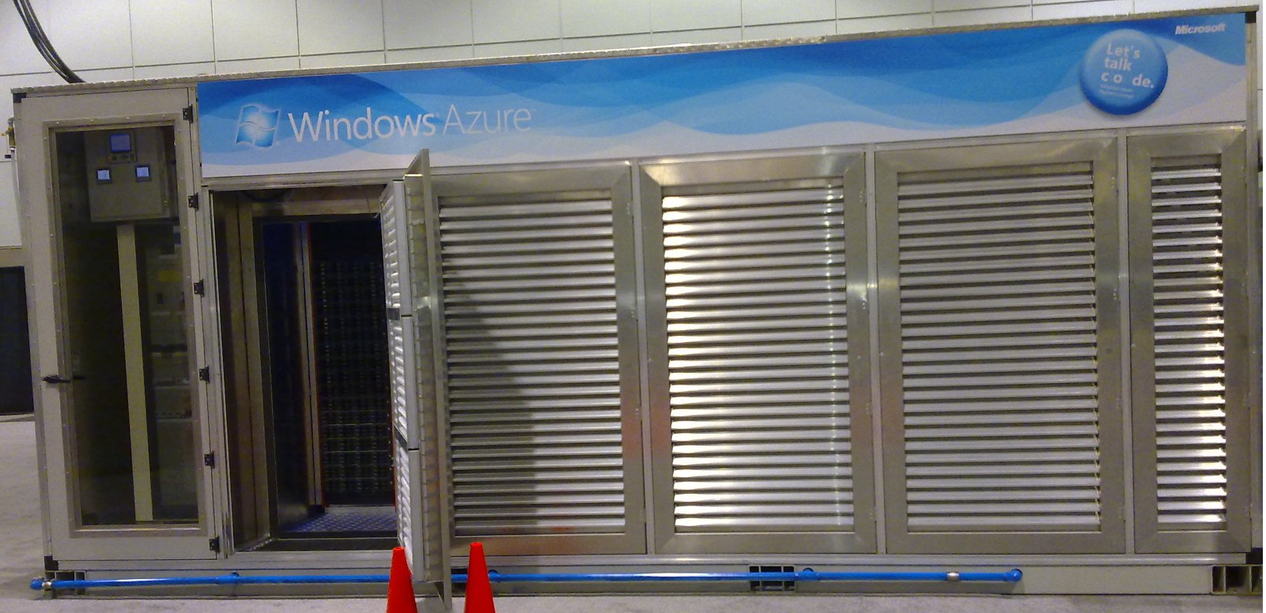
Azure datacenters
Tour to Datacenter: aka.ms/gfs-video

Slide 14
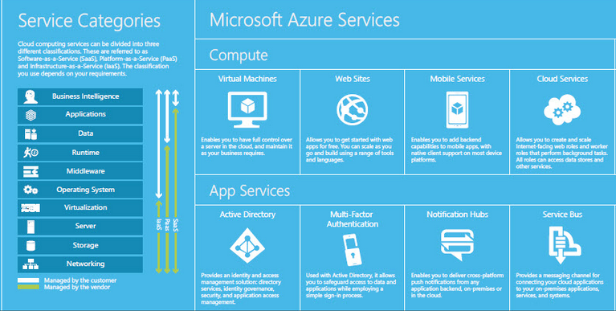

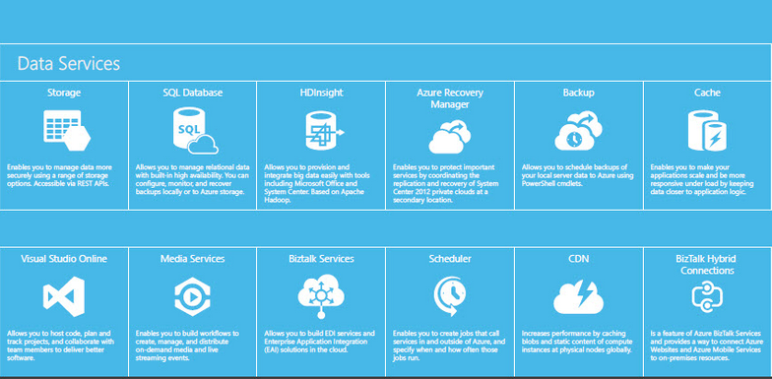
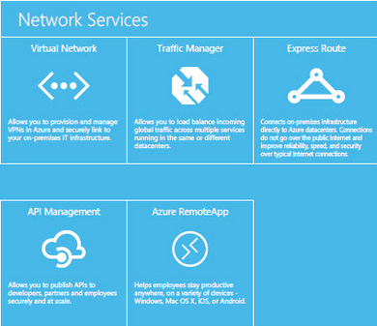
В клауде есть почти всё!

Slide 15
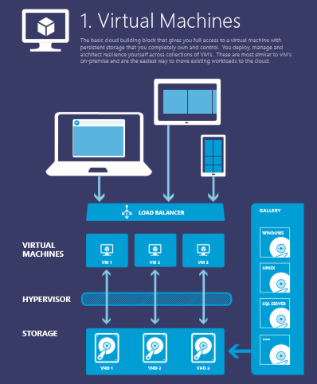
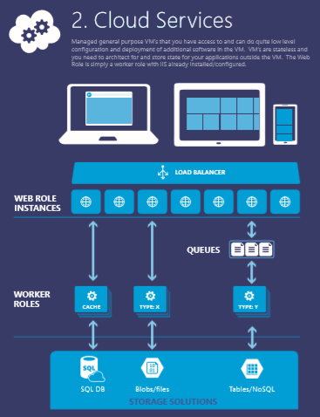
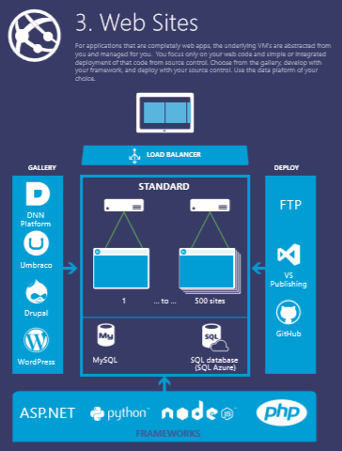
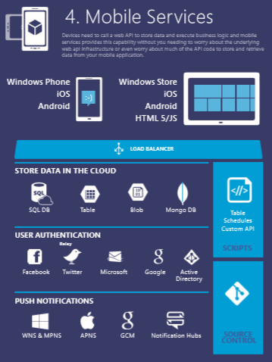
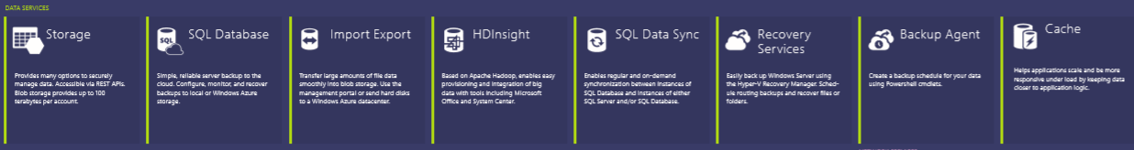




Notes:
You can use this to explain all the Azure building blocks – the compute services at the top and then the other blocks of services – data, networking, Apps…. OR you can go with the next set of slides… YOUR CHOICE…

Slide 16
>57%
Более 1,200,000
>250k
из Fortune 500 используют Azure
Активных вебсайтов
Баз Данных SQL в Azure
>40
МИЛЛИОНОВ
>350
ТРИЛЛИОНОВ объектов
>2
пользователей
AD
МИЛЛИОНА
Разработчиков, зарегистрировавшихся в Visual Studio Online
>2
МИЛЛИОНОВ запросов/сек
>18
МИЛЛИАРДОВ
аутентификаций/неделя

Slide 17
>375k
Azure Websites by the Numbers
>2Billion
Websites Hosted
Requests per Day
>200k
Unique
Customers
500
650
%
%
120
Yearly Traffic
Growth
Yearly Revenue
Growth
% Yearly Paid Subscription Growth

Slide 18

























Azure Websites Customers and Partners Folks doing interesting things on the platform
Notes:
Customers are enterprises (mostly .com) agencies, Microsoft. A lot of traction on CMS and WP.
Car companies do digital marketing campaigns, MSFT does blogs.
Airlines are using the platform to reach customer and host critical application.
Digital agencies (like Hogarth) are using Websites as a core platform on which they built solutions
MSIT looking at using Hybrid Connections for business apps. Good traction with Nordstrom on e-commerce

Slide 19







Who uses Azure Websites?

Slide 20
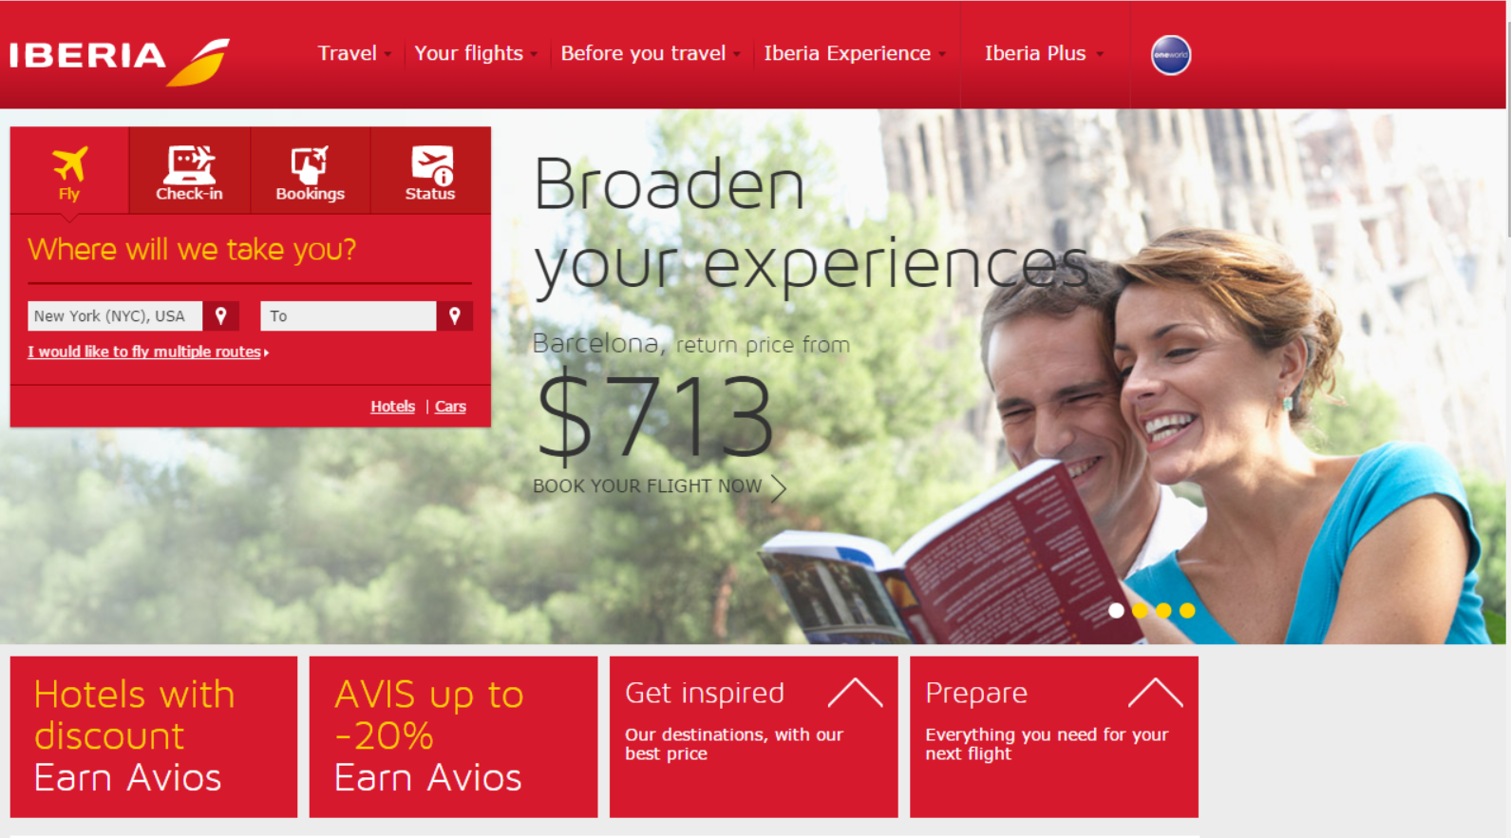
Objectives
Scalable e-commerce website to sell flights, both through travel agencies and directly to consumers
Tactics
Built Azure -based website using Umbraco and SQL on Azure for content and images.
Using VNET connecting on-premise
Results
Scalable Website with integration for Flight booking and Check In systems
Notes:
Timing: 2 minutes
Purpose: Share stories of customers that are reimagining their business using Microsoft technology. Select the stories that will resonate best with your customer. Additional customer case studies and references may be found at http://erdesk.
Key Points:
Customer Profile: Emirates is an international airline based in Dubai, United Arab Emirates. It operates more than 2,500 flights per week to 126 cities in 74 countries across six continents.
Business goal:
Tactics:
Results:
Additional Information: workingon case study

Slide 21
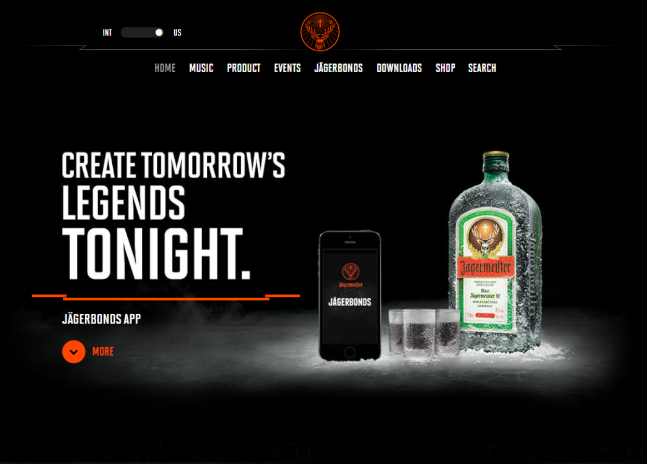
Jägermeister
Objectives
Create brand awareness and loyalty
Understand tastes and preferences of audience
Connect consumer through shared experiences
Tactics
Cloud-based website and mobile application for engaging customers through social media. video and audio features.
Results
Mobile app and Website JagerBonds allows posting photos and videos to Facebook or Instagram
Compile posts and pair them with songs
Notes:
Purpose: Share stories of customers that are reimagining their business using Microsoft technology. Select the stories that will resonate best with your customer. Additional customer case studies and references may be found at http://erdesk.
Key Points:
Customer Profile: Jägermeister is a German liqueur that is very popular with younger drinkers, and their website is squarely targeted at this demographic
Business goal: Enabling consumers with the ability to capture your legendary night out with friends through JägerBonds. From first shot to last call, the pictures, videos and posts everyone shares are turned into an epic music video.
Tactics: Both the website and the app run on Azure.
Results: The app gives customers a reason to use the app again and again, driving brand awareness and loyalty – by associating the brand with a great time out.

Slide 22
Azure Websites Features & Capabilities
Enterprise-class
Designed for secure mission-critical applications
Global scale
Optimized for Availability and Automatic scale
Built for DevOps
Agility through Continuous Deployment
Hybrid Connections / VPN Support
Scheduled Backup
Azure Active Directory Integration
Site Resiliency, HA, and DR
Web Jobs
Role Base Access Control
Audit / Compliance
Enterprise Migration
Client Certs
Redis Caching
IP Restrictions/ SSL
Web Sockets
SQL, MySQL, DocDB, & Mongo
Automated Deployment AutoScale
Built-in Load Balancing
WW Datacenter Coverage
End Point Monitoring & Alerts
App Gallery
DR Site Support
WildCard Support
Dedicated IP address
HTTP Compression
WebJobs
Sticky Sessions
Remote Debugging w/ Visual Studio
Site Staging Slots
Testing in Production
Continuous Integration/Deployment
Git, Visual Studio Online and GitHub
App & Site Diagnostics
OS & Framework Patching
Site Extensions Gallery
NET, PHP, Python, Node, Java
Framework Installer
Browser-based editing
Auto-Healing
Logging and Auditing
Note: Features to discuss today are in BOLD. Items with a * are to be released
Notes:
Customers are enterprises (mostly .com) agencies, Microsoft. A lot of traction on CMS and WP.
Car companies do digital marketing campaigns, MSFT does blogs.
MSIT looking at using Hybrid Connections for business apps. Good traction with Nordstrom on e-commerce

Slide 23
Site Extensions
foo.azurewebsites.net
foo.scm.azurewebsites.net
User Site
“Monaco”
WebDeploy
Upload to site
Install from gallery
“Kudu”
WebJobs
Pre-installed
Site Extensions
“Bring your own”
Site Extensions
Azure Web Site

Slide 24
I- Development and Deployment
Staged Publishing
traffic
traffic
Production
swap
Production
Staging
Developer
Developer

Slide 25
I- Development and Deployment
Testing in Production
100% production.com
Production
swap
Staging
Developer

Slide 26
I- Development and Deployment
Testing in Production
80% production.com
Production
20% production.com
swap
Staging
Developer

Slide 27
II- Debugging and Investigations
Kudu
https://<mySite>.scm.azurewebsites.net/
Authenticated
Runs in the same security context as the main site
Can access the site files and environment variables
Great for admin and debugging tools

Slide 28
III- Management and Administration
Azure Portal(s)
Visual Studio
Azure API
IIS Manager
Azure Web Site
xplat CLI
PowerShell

Slide 29
Azure Websites Features & Capabilities
Enterprise-class
Designed for secure mission-critical applications
Global scale
Optimized for Availability and Automatic scale
Built for DevOps
Agility through Continuous Deployment
Hybrid Connections / VPN Support
Scheduled Backup
Azure Active Directory Integration
Site Resiliency, HA, and DR
Web Jobs
Role Base Access Control
Audit / Compliance
Enterprise Migration
Client Certs
Redis Caching
IP Restrictions/ SSL
Web Sockets
SQL, MySQL, DocDB, & Mongo
Automated Deployment AutoScale
Built-in Load Balancing
WW Datacenter Coverage
End Point Monitoring & Alerts
App Gallery
DR Site Support
WildCard Support
Dedicated IP address
HTTP Compression
WebJobs
Sticky Sessions
Remote Debugging w/ Visual Studio
Site Staging Slots
Testing in Production
Continuous Integration/Deployment
Git, Visual Studio Online and GitHub
App & Site Diagnostics
OS & Framework Patching
Site Extensions Gallery
NET, PHP, Python, Node, Java
Framework Installer
Browser-based editing
Auto-Healing
Logging and Auditing
Note: Features to discuss today are in BOLD. Items with a * are to be released
Notes:
Customers are enterprises (mostly .com) agencies, Microsoft. A lot of traction on CMS and WP.
Car companies do digital marketing campaigns, MSFT does blogs.
MSIT looking at using Hybrid Connections for business apps. Good traction with Nordstrom on e-commerce

Slide 30
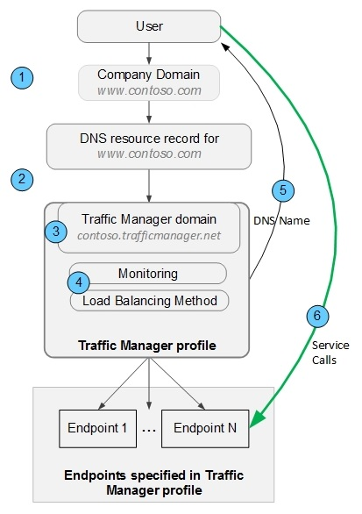
Traffic Manager – how it works ?
Notes:
1,000 new customers per day
1,000,000 cores milestone achieved September last year
1.6 Hexabyte milestones achieved at the end of last year

Slide 31

Use Azure to load
Balancing (round robin)
www.cloudtechnologies.ru
VM ( abokov.cloudapp.net )
abokov.trafficmanager.net
Mode: roundrobin
abokov-site.azurewebsites.net
( backup replica )
Notes:
1,000 new customers per day
1,000,000 cores milestone achieved September last year
1.6 Hexabyte milestones achieved at the end of last year

Slide 32

Use Azure as disaster recovery for your site
www.cloudtechnologies.ru
Linux VM ( abokov.cloudapp.net )
abokov.trafficmanager.net
Mode: Failover
Backup web-site
abokov-site.azurewebsites.net
Notes:
1,000 new customers per day
1,000,000 cores milestone achieved September last year
1.6 Hexabyte milestones achieved at the end of last year

Slide 33
Подробнее о способах приобретения Microsoft Azure
На azure.com
Корпоративное соглашение
EA
Программы Open License
Оплата по мере использования от 1 месяца
Приобретение у наших партнеров по модели Open Licensing 12 месяцев
Контракты от 3-х лет
Enterprise Agreement и Enterprise Agreement(SCE)
PAY-AS-YOU-GO или оплата по мере использования предполагает гибкие возможности без первоначальных затрат и отсутствие долговременных обязательств
Данный вариант оплаты может быть полезен для предприятий малого и среднего бизнеса, а также для индивидуальных разработчиков, для задач требующих небольшого количества ресурсов с возможностью расширения в будущем.
Для использования этого варианта оплаты необходимо наличие кредитной карты.
Все детали вы можете узнать по aka.ms/msazurerupayg
Приобретение у наших партнеров
Возможность оплаты ресурсов Microsoft Azure от 5000 рублей на 12 месяцев с возможностью пополнения счета подписки в любой момент, все подробности aka.ms/msazureruopen
Данный вариант оплаты может быть полезен для предприятий малого и среднего бизнеса, а также для индивидуальных разработчиков
Для использования данного варианта оплаты не требуется кредитная карта, все документы предоставляются в соответсвии с российским бухучетом
Enterprise - Enterprise Agreement и Enterprise Agreement Subscription. Данный вариант приобретения предполагает предварительную оплату ресурсов Microsoft Azure
Размер скидки до 35%*
Приобретение доступно у наших партнеров со статусом Large Account Reseller.
Данный вариант приобретения предназначен для компаний корпоративного сегмента, все подробности можно прочитать http://aka.ms/msazureruea
или узнать у наших партнеров
pinpoint.microsoft.com/ru-ru
Notes:
Today Azure can be purchased either directly from Microsoft.com, or with an EA.
When Azure is available in Open, there will be another option available, and one that is familiar to tens of thousands of partners.
Each purchasing path has advantages and will be right for different types of partners and customers. Open is simply another option that has the benefits we discussed on the previous slide.

Slide 34

Бизнес поддержка для партнеров-разработчиков
Мы делаем co-marketing
Прямой технический и бизнес контакт в Microsoft
Выгодные цены
Ранний доступ к бетам и превью
Участие в наших событиях
Go-To-Market на глобальном уровне практически в любом регионе мира

Slide 35

Бесплатные опции
30 дневный триал на windowsazure.com
Триал для MSDN подписчиков
Для стартапов - BizSpark на 3 года – включает в себя 5 MSDN подписок!
Windows Azure Offer $60K (BizSpark+) – облако на 1 год на $60 000 ( на конкурсной основе )

Slide 36





Полезные ресурсы
Изучайте и присоединяйтесь!
Центр разработки
azurehub.ru
Портал Windows Azure
azure.com
Контактный емейл для всех вопросов по Windows Azure
AzureRus@microsoft.com
Сообщество пользователей
facebook.com/groups/azurerus
Последние новости
@windowsazure_ru

